Slide 1
Federal Agencies and Nuclear Physics
James Sowinski

Slide 2
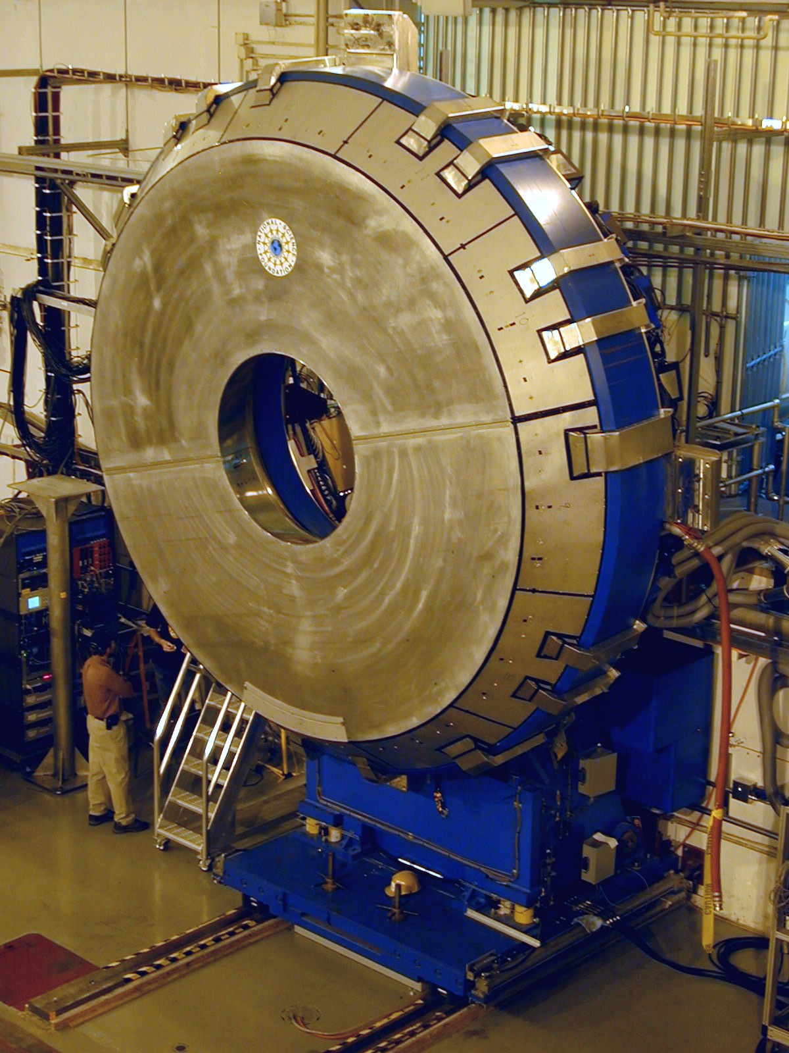
My Background
PhD in Nuclear Physics – Univ. of Wisconsin
26 years as Research Scientist at Indiana University
Indiana University Cyclotron Facility
DESY/HERMES
RHIC/STAR
12.5 years at DOE Office of Nuclear Physics
Program Manager for Facilities and acting Heavy Ions

Slide 3
My Background
Currently retired
I no longer represent DOE/NP
Information I present is publicly available
Much presented is directly from agency web sites

Slide 4
DOE History
Manhattan Project -1942
Los Alamos, Oak Ridge, Hanford
1944 congressional authorization for establishment of energy research laboratories
1946 Atomic Energy Commission established
1947 Brookhaven, Livermore, Savannah River
1953-4 Atoms for Peace, Civilian Nuclear power
1954 Bevatron at Berkeley Radiation Lab
1962 Grant issued to construct Stanford Linear Accelerator
Civilian power reactors coming on line, weapons testing

Slide 5
DOE History
1967 National Accelerator Lab (later called Fermi Lab) authorized
1973 Oil crises – decades of conventional and nuclear energy concerns – Federal Energy Office
1974
Federal Energy Administration
AEC becomes Energy Research and Development Administration
Nuclear Regulatory Commission established
1977 ERDA and FEA combined into Dept. of Energy
1992 Superconducting Super Collider canceled
1992 Last weapons test

Slide 6
DOE History
1995 Fermi Lab announces top quark discovery
1998 Office of Energy Research changed to Office of Science
1999 National Spherical Torus Experiment begins at Princeton Plasma Physics Laboratory
National Ignition Facility at Livermore
Spallation Neutron Souce at ORNL initiated
2000 National Nuclear Security Admin. Established
Human Genome project initiated by DOE
Tau neutrino discovered at Fermi Lab
https://www.energy.gov/lm/doe-history https://science.osti.gov/About/History

Slide 7
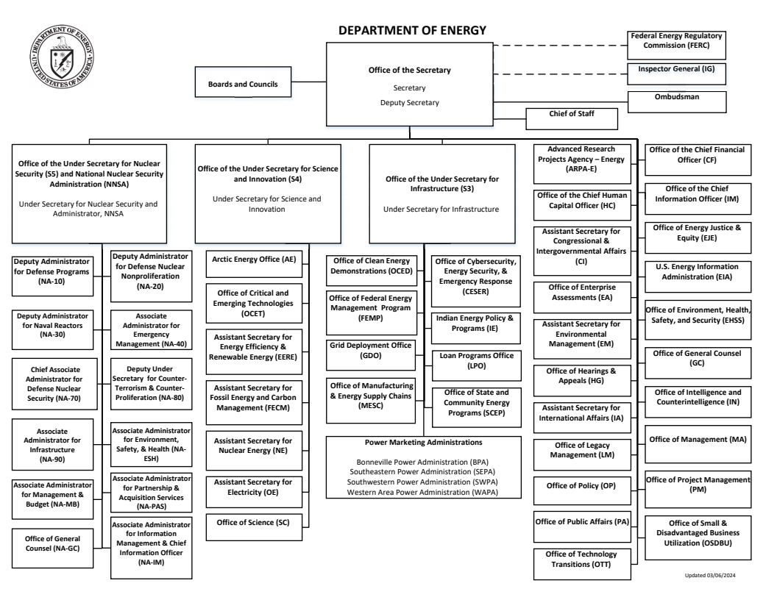
National Nuclear Security Admin.
Secretary of Energy
Science and Innovation
3 Under Secretaries
Infrastructure
Office of Science

Slide 8
DOE
Recent Secretaries
Steven Chu – Physicist – Nobel Laureate
Ernest Moniz – Nuclear Physicist – Energy Policy
Rick Perry – ex-Governor of Texas
Dan Brouillette – Congressional staffer, Deputy Secretary
Jennifer Granholm – ex-Governor of Michigan -current
Typically change with presidential administrations
One or two presentations to Office of Science a year
Regularly tour DOE labs and Science Facilities

Slide 9
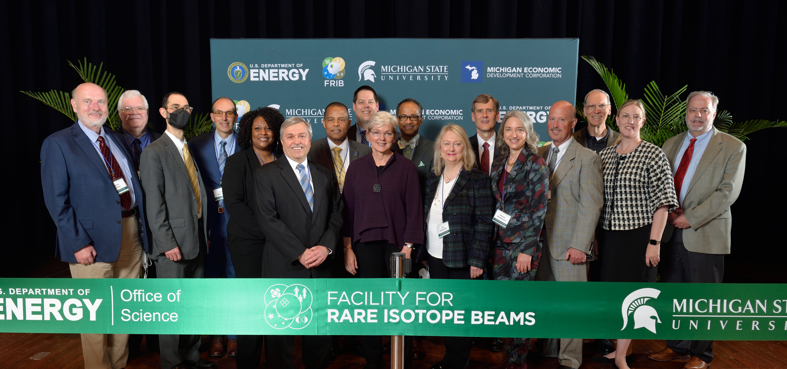
Secretary Granholm (and me) at RHIC Ribbon Cutting

Slide 10
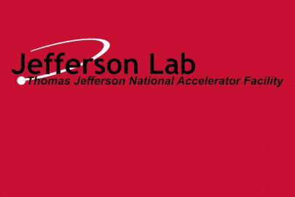
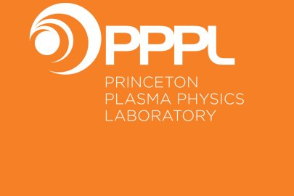
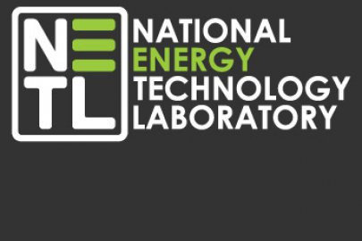
DOE Laboratories
Office of Science
NNSA
Other DOE

Slide 11
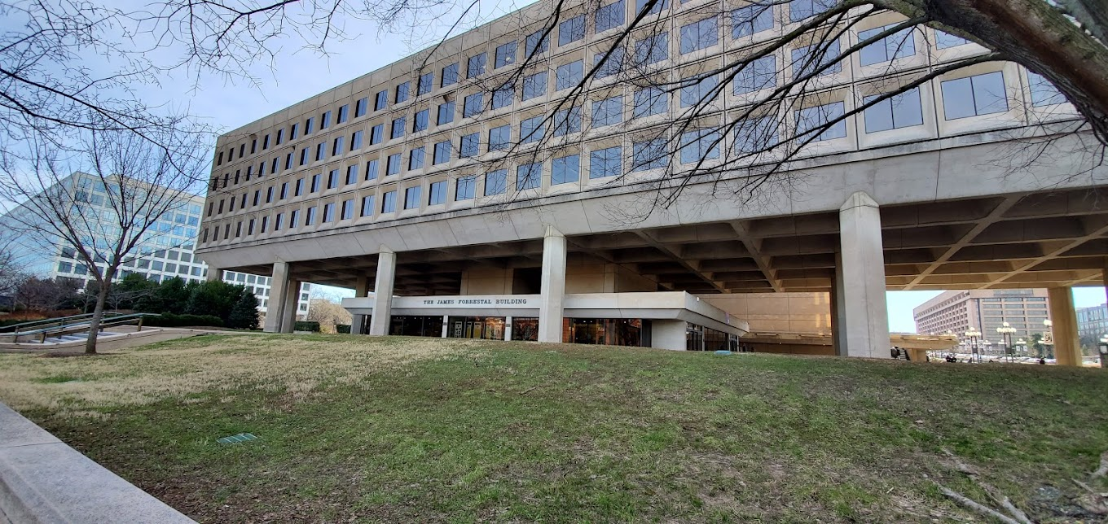
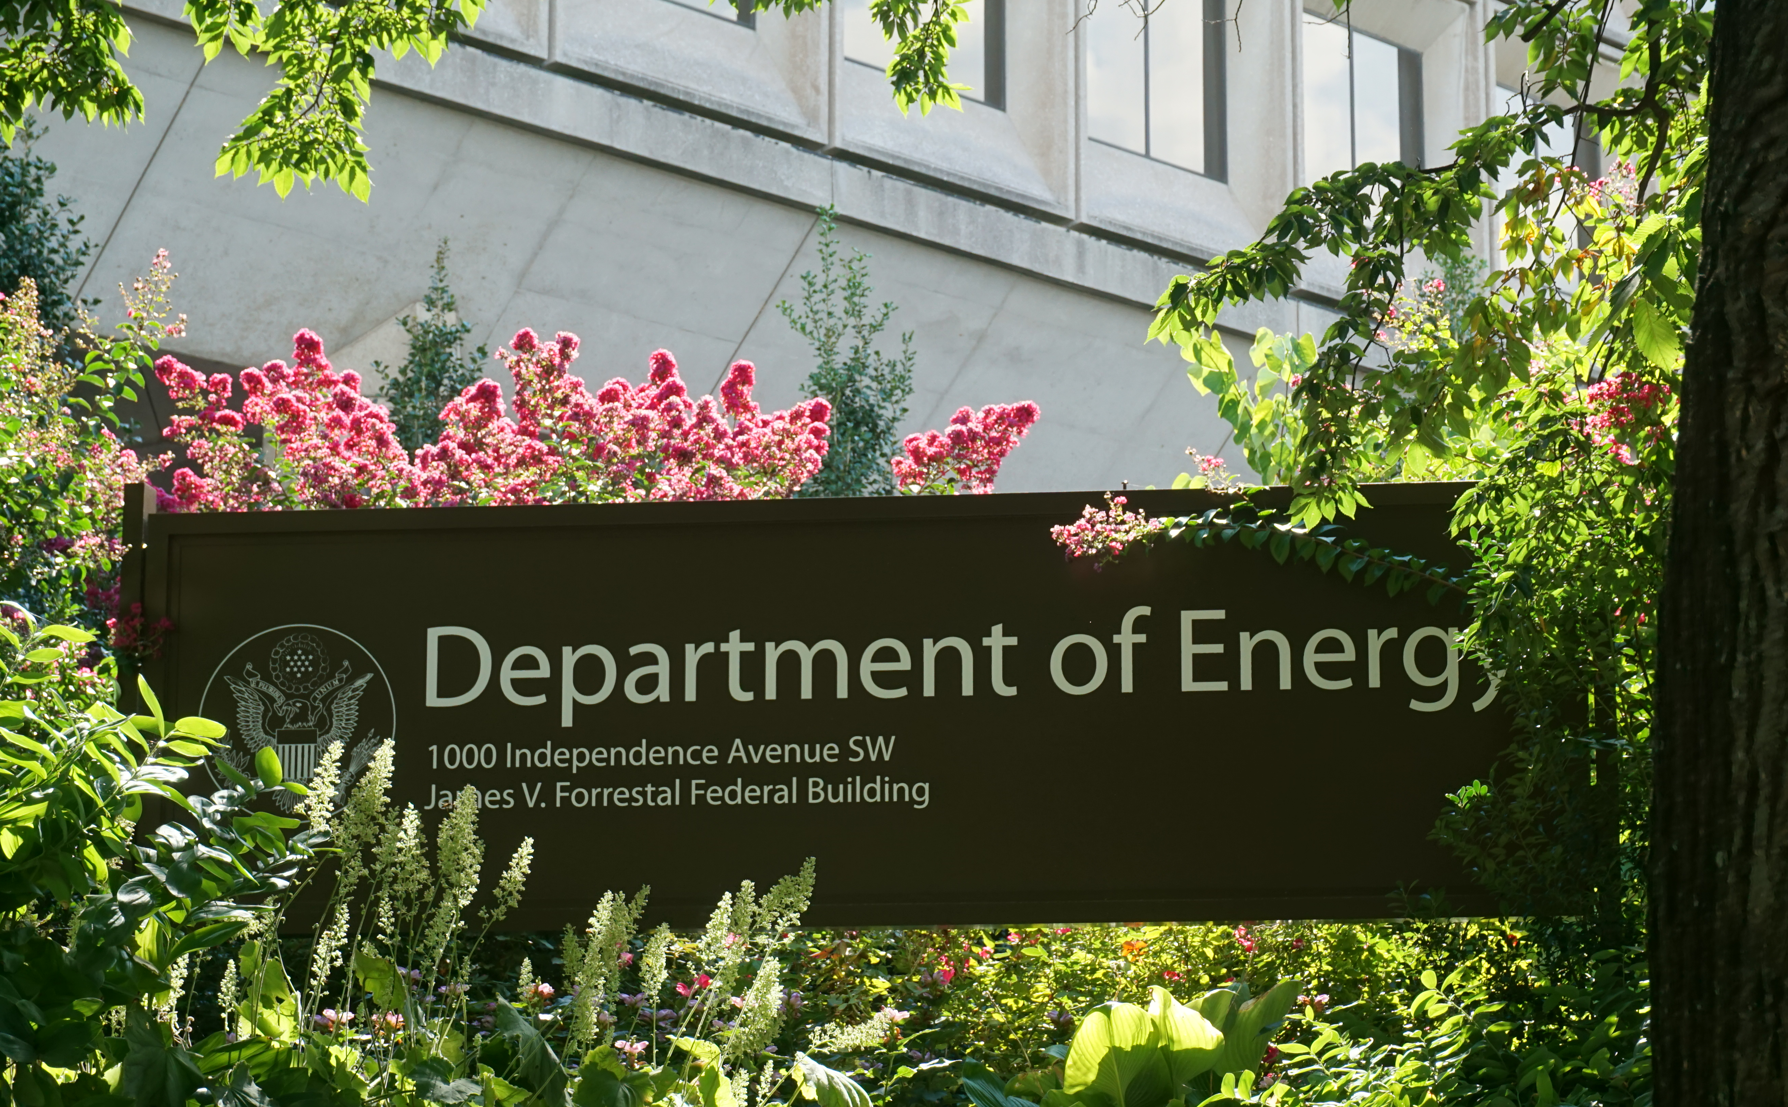
DOE Headquarters Forrestal Building
In DC just off the Mall across from the Smithsonian Castle
Offices of leadership and their staff including Secretary and Director of Office of Science
Small publicly available historical display in lobby

Slide 12
Program Offices in Germantown Building
Original AEC and current Secretary remote offices
1950’s AEC in DC
Worried about nuclear weapon on DC and losing AEC staff
Build new building outside the radius of 20 M-ton bomb
Aligned to adsorb blast from south
Reinforced and other features
Office of Science has other business offices around country
My office on 4th floor
DC to south east

Slide 13
DOE Office of Science
The mission of DOE’s Office of Science is to deliver scientific discoveries and major scientific tools to transform our understanding of nature and advance the energy, economic, and national security of the United States.

Slide 14
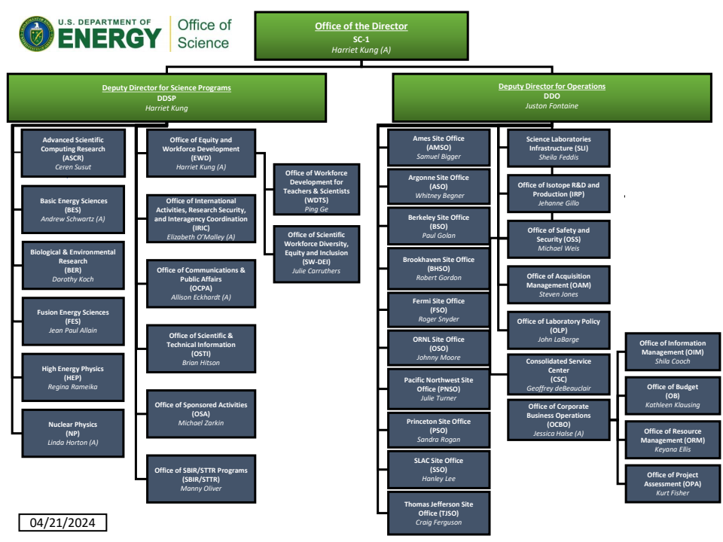
Director – Presidential appointee
Science Programs
Operations
Advanced Scientific Computing
Isotope R&D and Production
Basic Energy Sciences
Biological and Envioronmental Research
Fusion Energy Sciences
High Energy Pysics
Nuclear Physics

Slide 15
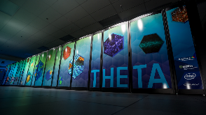
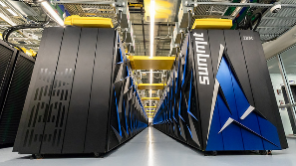
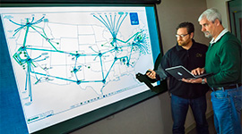
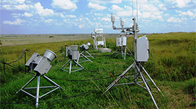
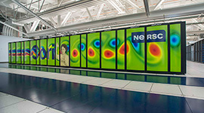
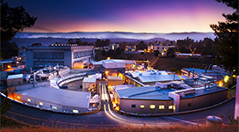
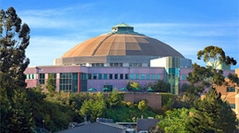
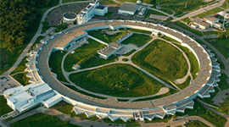
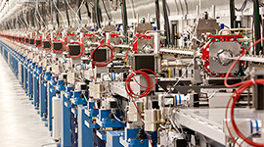
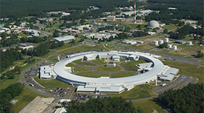
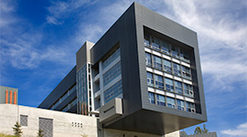
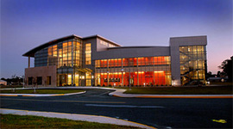
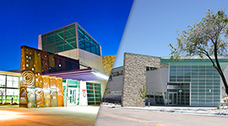
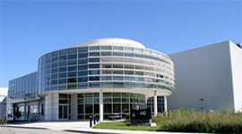
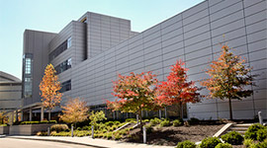
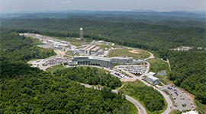
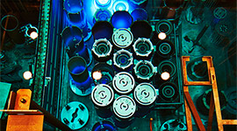
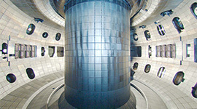
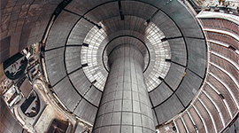
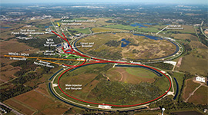
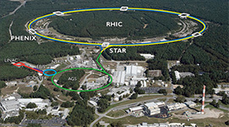
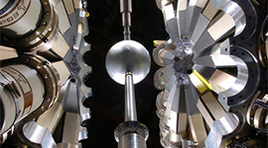
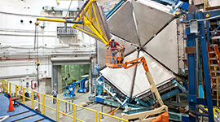
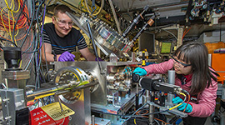
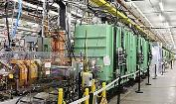
Office of Science User Facilities
Number of User Facilities
28
ALCF
OLCF
ESnet
EMSL
ARM
JGI
NERSC
SSRL
ALS
LCLS
NSLS-II
TMF
APS
FACET II
CFN
CINT
CNM
CNMS
SNS
HFIR
DIII-D
NSTX-U
Fermilab AC
RHIC
ATLAS
CEBAF
ATF
FRIB

Slide 16
Physics Research
Facilities and Project Management
Heavy Ions
Medium Energy and Quantum information
Detector R&D
NP Facilities
Nuclear Structure and Astrophysics
Major Projects
Nuclear Theory
Detector Projects
Nuclear Data
Industry R&D
Fundamental Symmetries
International Cooperation and Outreach
NP Computing

Slide 17
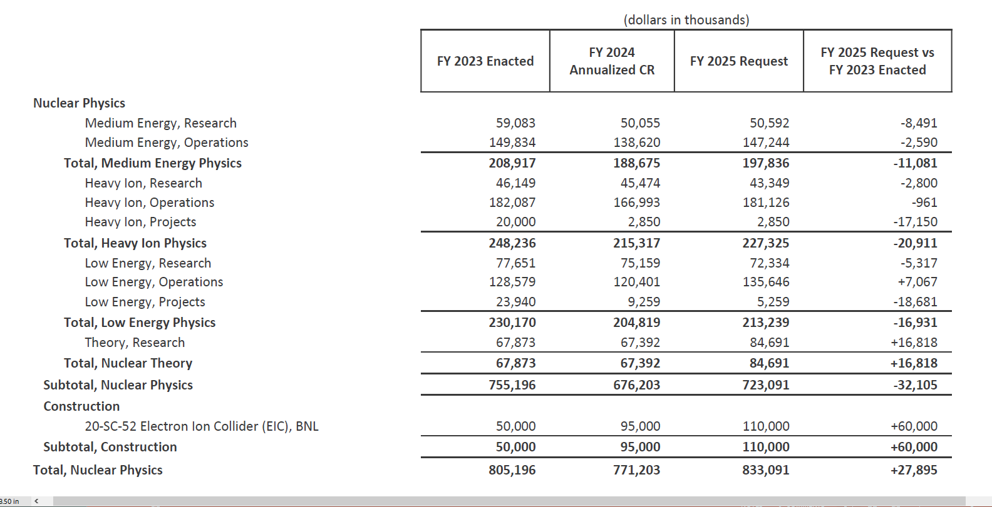
Nuclear Physics Funding
2025 President’s Request
https://www.energy.gov/science/office-science-budget

Slide 18
The NP Mission: Discovering, Exploring, and Understanding all Forms of Nuclear Matter
National User Facilities ~4,300 users
RHIC (BNL)
CEBAF (TJNAF)
ATLAS (ANL)
FRIB (MSU)
Research Groups
9 National Laboratories
93 Universities
NP Workforce
~807 Faculty & Lab Res Staff
~376 Post-docs
~540 Graduate Students
~1,500 Lab technical/admin
~100 Undergraduate Students
CENPA
INT
PNNL
Other Lab. Facilities
88-Inch Cyclotron (LBNL)
200 MeV BLIP (BNL)
100 MeV IPF (LANL)
Hot Cell Facilities at BNL, LANL, ORNL
INL
FRIB
ANL
MIT
BNL
LLNL
TJNAF
LBNL
ORNL
LANL
TUNL
Centers of Excellence
CENPA (U. of Wash)
INT (U. of Wash.)
TAMU (Texas A&M)
TUNL (Duke)
REC (MIT)
User Facility
TAMU
University
Laboratory Facility
Laboratory
$713M in FY2021
University Facility/
Center of Excellence
Notes:
Updated
18

Slide 19
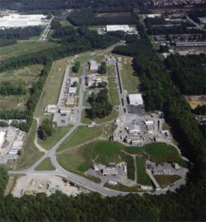
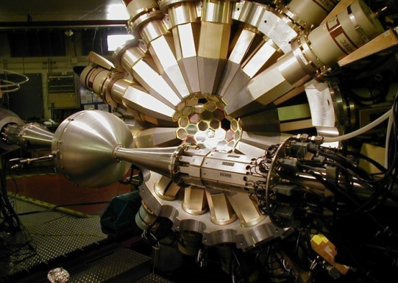
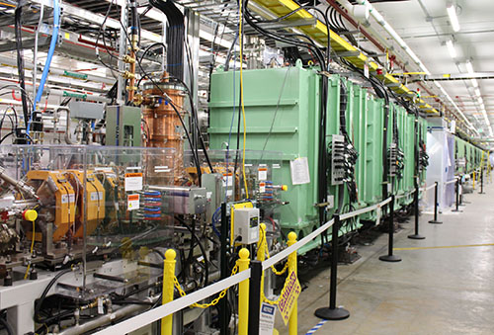
The four NP User Facilities
Relativistic Heavy Ion Collider
Continuous Electron Beam Accelerator Facility
Argonne Tandem Linac System
Facility for Rare Isotope Beams

Slide 20
Medium Energy Program
Tests of QCD
What is the internal landscape of the protons and neutrons (collectively known as nucleons)?
What does QCD predict for the properties of strongly interacting matter?
What is the role of gluons and gluon self-interactions in nucleons and nuclei?
CEBAF/Jlab and spin physics at RHIC/BNL
Select experiments at HIGS/TUNL, FNAL, MIT Engineering Center
Electron Ion Collider in future
Lab groups at TJNAF, BNL, ANL, LANL, and LBNL

Slide 21
Heavy Ion Program
Nuclear matter at extremely high densities and temperatures
What are the phases of strongly interacting matter, and what roles do they play in the cosmos?
What governs the transition of quarks and gluons into pions and nucleons?
What determines the key features of QCD and their relation to the nature of gravity and space-time?
RHIC and EIC in future
LHC with ALICE, ATLAS and CMS
Lab Groups at BNL, LBNL, LANL, and ORNL

Slide 22
Nuclear Theory
Theoretical support needed to interpret experimental data in the subprograms and to advance new ideas and hypotheses that identify potential areas for future experiments
Development of an understanding of the mechanisms and effects of quark confinement and deconfinement
New theoretical and computational tools are developed to describe nuclear many-body phenomena
Nuclear astrophysics - efforts to understand the origins of the elements in the cosmos and what the nature of the neutrino may reveal about the evolution of the early universe.
Institute for Nuclear Theory at University of Washington and the FRIB Theory Alliance at Michigan State University
Lattice QCD, SciDAC, Quantum Information Sciences, Quantum Computing
Nuclear Data, RENEW FAIR programs
Lab Groups at ANL, BNL, LANL, LBNL, LLNL, ORNL,and TJNAF

Slide 23
Nuclear Structure and Nuclear Astrophysics
Questions addressed include
What is the nature of the nuclear force that binds protons and neutrons into stable nuclei and rare isotopes? What is the origin of simple patterns in complex nuclei? What is the nature of neutron stars and dense nuclear matter?
What are the origins of the elements in the cosmos? What are the nuclear reactions that drive stars and stellar explosions?
Operations of FRIB/MSU and ATLAS/ANL user facilities
Three Centers of Excellence, Cyclotron Institute at Texas A&M Univ., Triangle Universities Nuclear Laboratory at Duke Univ., Center for Experimental Nuclear Physics and Astrophysics at the Univ. of Washington
Operations of LBNL 88-Inch Cyclotron for an in-house program
Lab Groups at ANL, LBNL, LLNL, and ORNL

Slide 24
Fundamental Symmetries
Questions addressed include
What is the nature of neutrinos, what are their masses, and what role have they played in creating the imbalance between matter and antimatter in our universe?
Is there evidence from the electric-dipole moments of atomic nuclei and the neutron that indicate our current understanding of the fundamental laws governing nuclear physics is incomplete?
Will precise measurements in electron scattering and the decay of nuclei indicate the existence of forces that were present at the dawn of the universe, and disappeared from view as the universe evolved?
SC steward of neutrino mass measurements KATRIN and PROJECT8 and neutrino-less double beta decay CUORE, LEGEND-200, planning for ton scale
Parity violating electron scattering MOLLER
Electric dipole moments and other neutron properties at the FNPB/SNS/ORNL
Lab Groups at BNL, LANL, LBNL, LLNL, ORNL, PNNL and SLAC

Slide 25
Other DOE NP Programs
Nuclear Data
multi-disciplinary with applications to energy, defense, space, and medicine
collects, evaluates, and disseminates nuclear data with support of the U.S. Nuclear Data Program and the National Nuclear Data
Research funded in coordination with the Nuclear Data InterAgency Working Group

Slide 26
Other DOE NP Programs
Nuclear Physics Computing
Research in nuclear physics that rely on large-scale, high-performance computing
Scientific Discovery through Advanced Computation (SciDAC) and Nuclear Theory Topical Collaborations
Lattice QCD
Exascale projects in LQCD and nuclear astrophysics
Access to computing resources at DOE leadership computers and the National Energy Research Scientific Computing center (NERSC)

Slide 27
Other DOE NP Programs
Quantum Information Science
Research that could, in the long-term, have a transformative impact on the NP mission area and/or advance QIS development enabled by NP-supported science, technologies, and laboratory infrastructure
Topics may include quantum computation, quantum simulations and simulators, quantum sensing, quantum-enhanced nuclear physics detectors, nuclear many-body problem, ‘squeezed’ quantum states, nuclear qubits quantum entanglement, and implementation of NP theories on quantum hardware
Industrial Concepts – Small Business Innovation Research
Technology development of interest to NP with potential for commercialization

Slide 28
Grant Process for Universities at DOE NP
FY 202x CONTINUATION OF SOLICITATION FOR THE OFFICE OF SCIENCE FINANCIAL ASSISTANCE PROGRAM
Medium Energy, Heavy Ions, Low Energy/Astrophysics, Fundamental Symmetries, Nuclear Theory
Accept proposals each year, new and renewal - format indicated in FOA
Group or individual PIs
Typical proposal is for 3 years
Summer salary, post docs, grad students, possibly other staff, travel, possibly some equipment
Proposals are letter reviewed and then rated by panel separately for each program
For successful proposals, 3yr budget negotiated (but subject to approp.)
Lab groups funded and reviewed separately
https://science.osti.gov/grants/FOAs/Open

Slide 29
DOE support for Graduate Students Research at National Labs
Office of Science Graduate Student Research Program
Advance PhD thesis research while working at a Department of Energy National Laboratory
U.S. citizens or lawful permanent residents
Conduct part of their PhD thesis research at a host DOE laboratory/facility in collaboration with a DOE National Laboratory scientist
https://science.osti.gov/wdts/scgsr

Slide 30
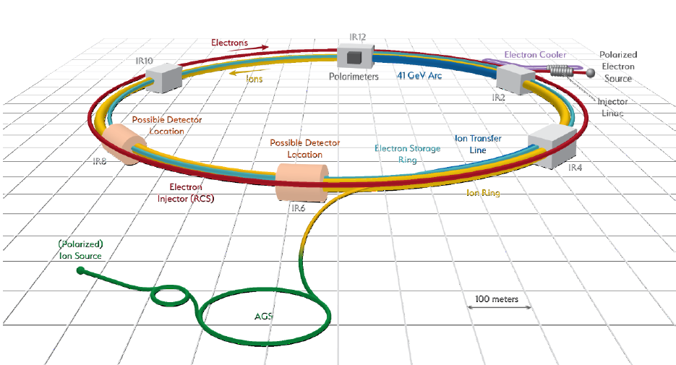
DOE NP Construction – Electron Ion Collider
RHIC converted to EIC
Estimated completion FY33
How does the mass of the nucleon arise?
How does the spin of the nucleon arise?
What are the emergent properties of dense systems of gluons?”
BNL and TJNAF $1.7B-$2.8B Large international participation
Funded project includes one detector -ePIC

Slide 31
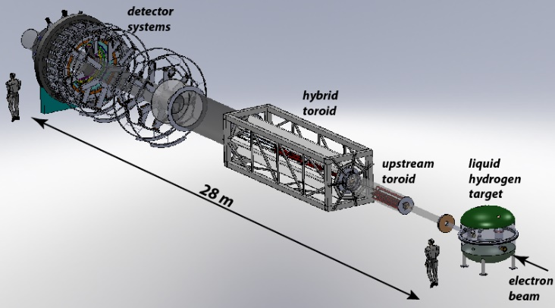
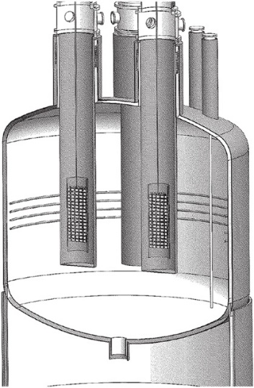
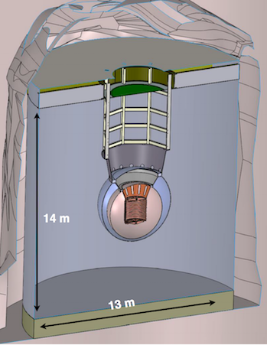
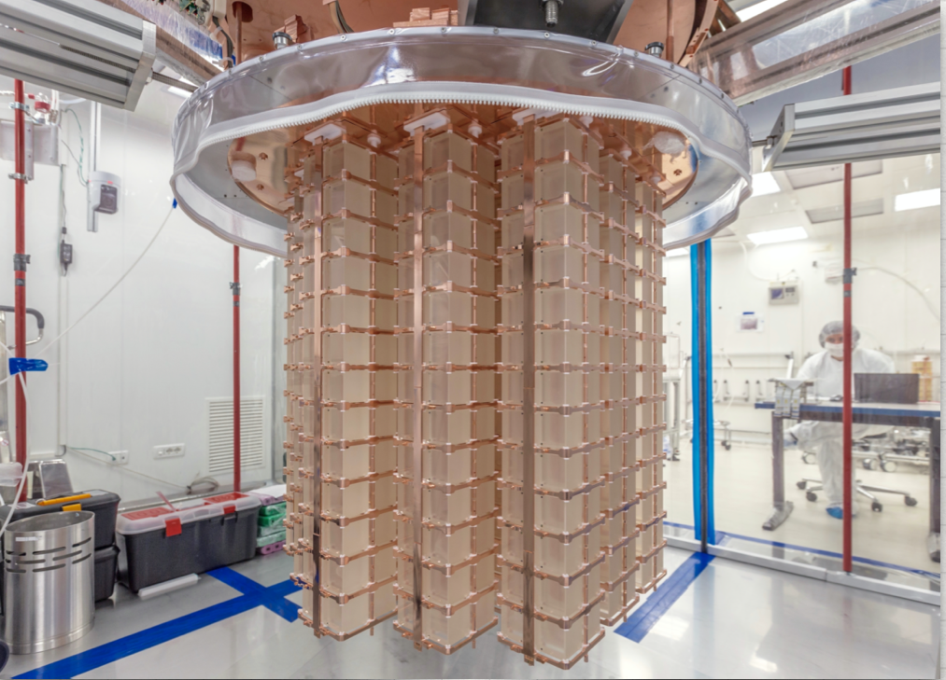
Major Items of Equipment
GRETA Low E Labs Construction underway $58.3M complete 3/28
HRS FRIB Alternative and cost range defined $85M-$111M complete Q2 FY29
Moller Jlab Long Lead Procurement $45.8M to $56.6M complete Q2 FY28
Ton scale NLDBD Mission Need established $350M - $500M timescale TBD

Slide 32
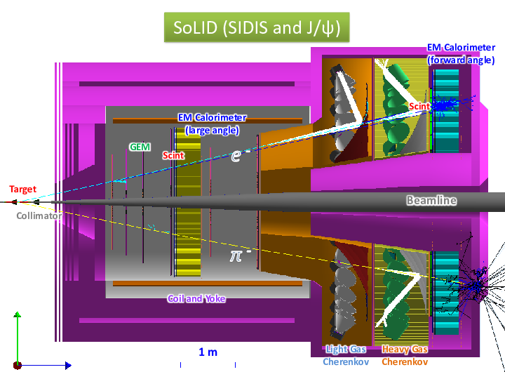
Envisioned Future Major Projects
SoLID at Jlab
FRIB 400 MeV/c upgrade
Project 8 neutrino mass
EIC Detector II at 2nd^{nd} interaction point

Slide 33
Most Program Managers are Federal Employees
Federal employees take an oath:
l will support and defend the Constitution of the United States against all enemies, foreign and domestic; that I will bear true faith and allegiance to the same; that I take this obligation freely, without any mental reservation or purpose of evasion; and that I will well and faithfully discharge the duties of the office on which I am about to enter. So help me God.
Subject to Hatch Act
Restricts partisan activities at work
Restricts running for partisan office and fund raising
Temporary university or lab personnel, IPAs, can serve under Intergovernmental Personnel Act

Slide 34
National Science Foundation
In 1945, Vannever Bush report, Science: The Endless Frontier. The report envisioned a new agency whose mission would promote the progress of science by supporting basic research at colleges and universities.
Established by law in 1950
Mission: To promote the progress of science; to advance the national health, prosperity, and welfare; and to secure the national defense; and for other purposes.

Slide 35
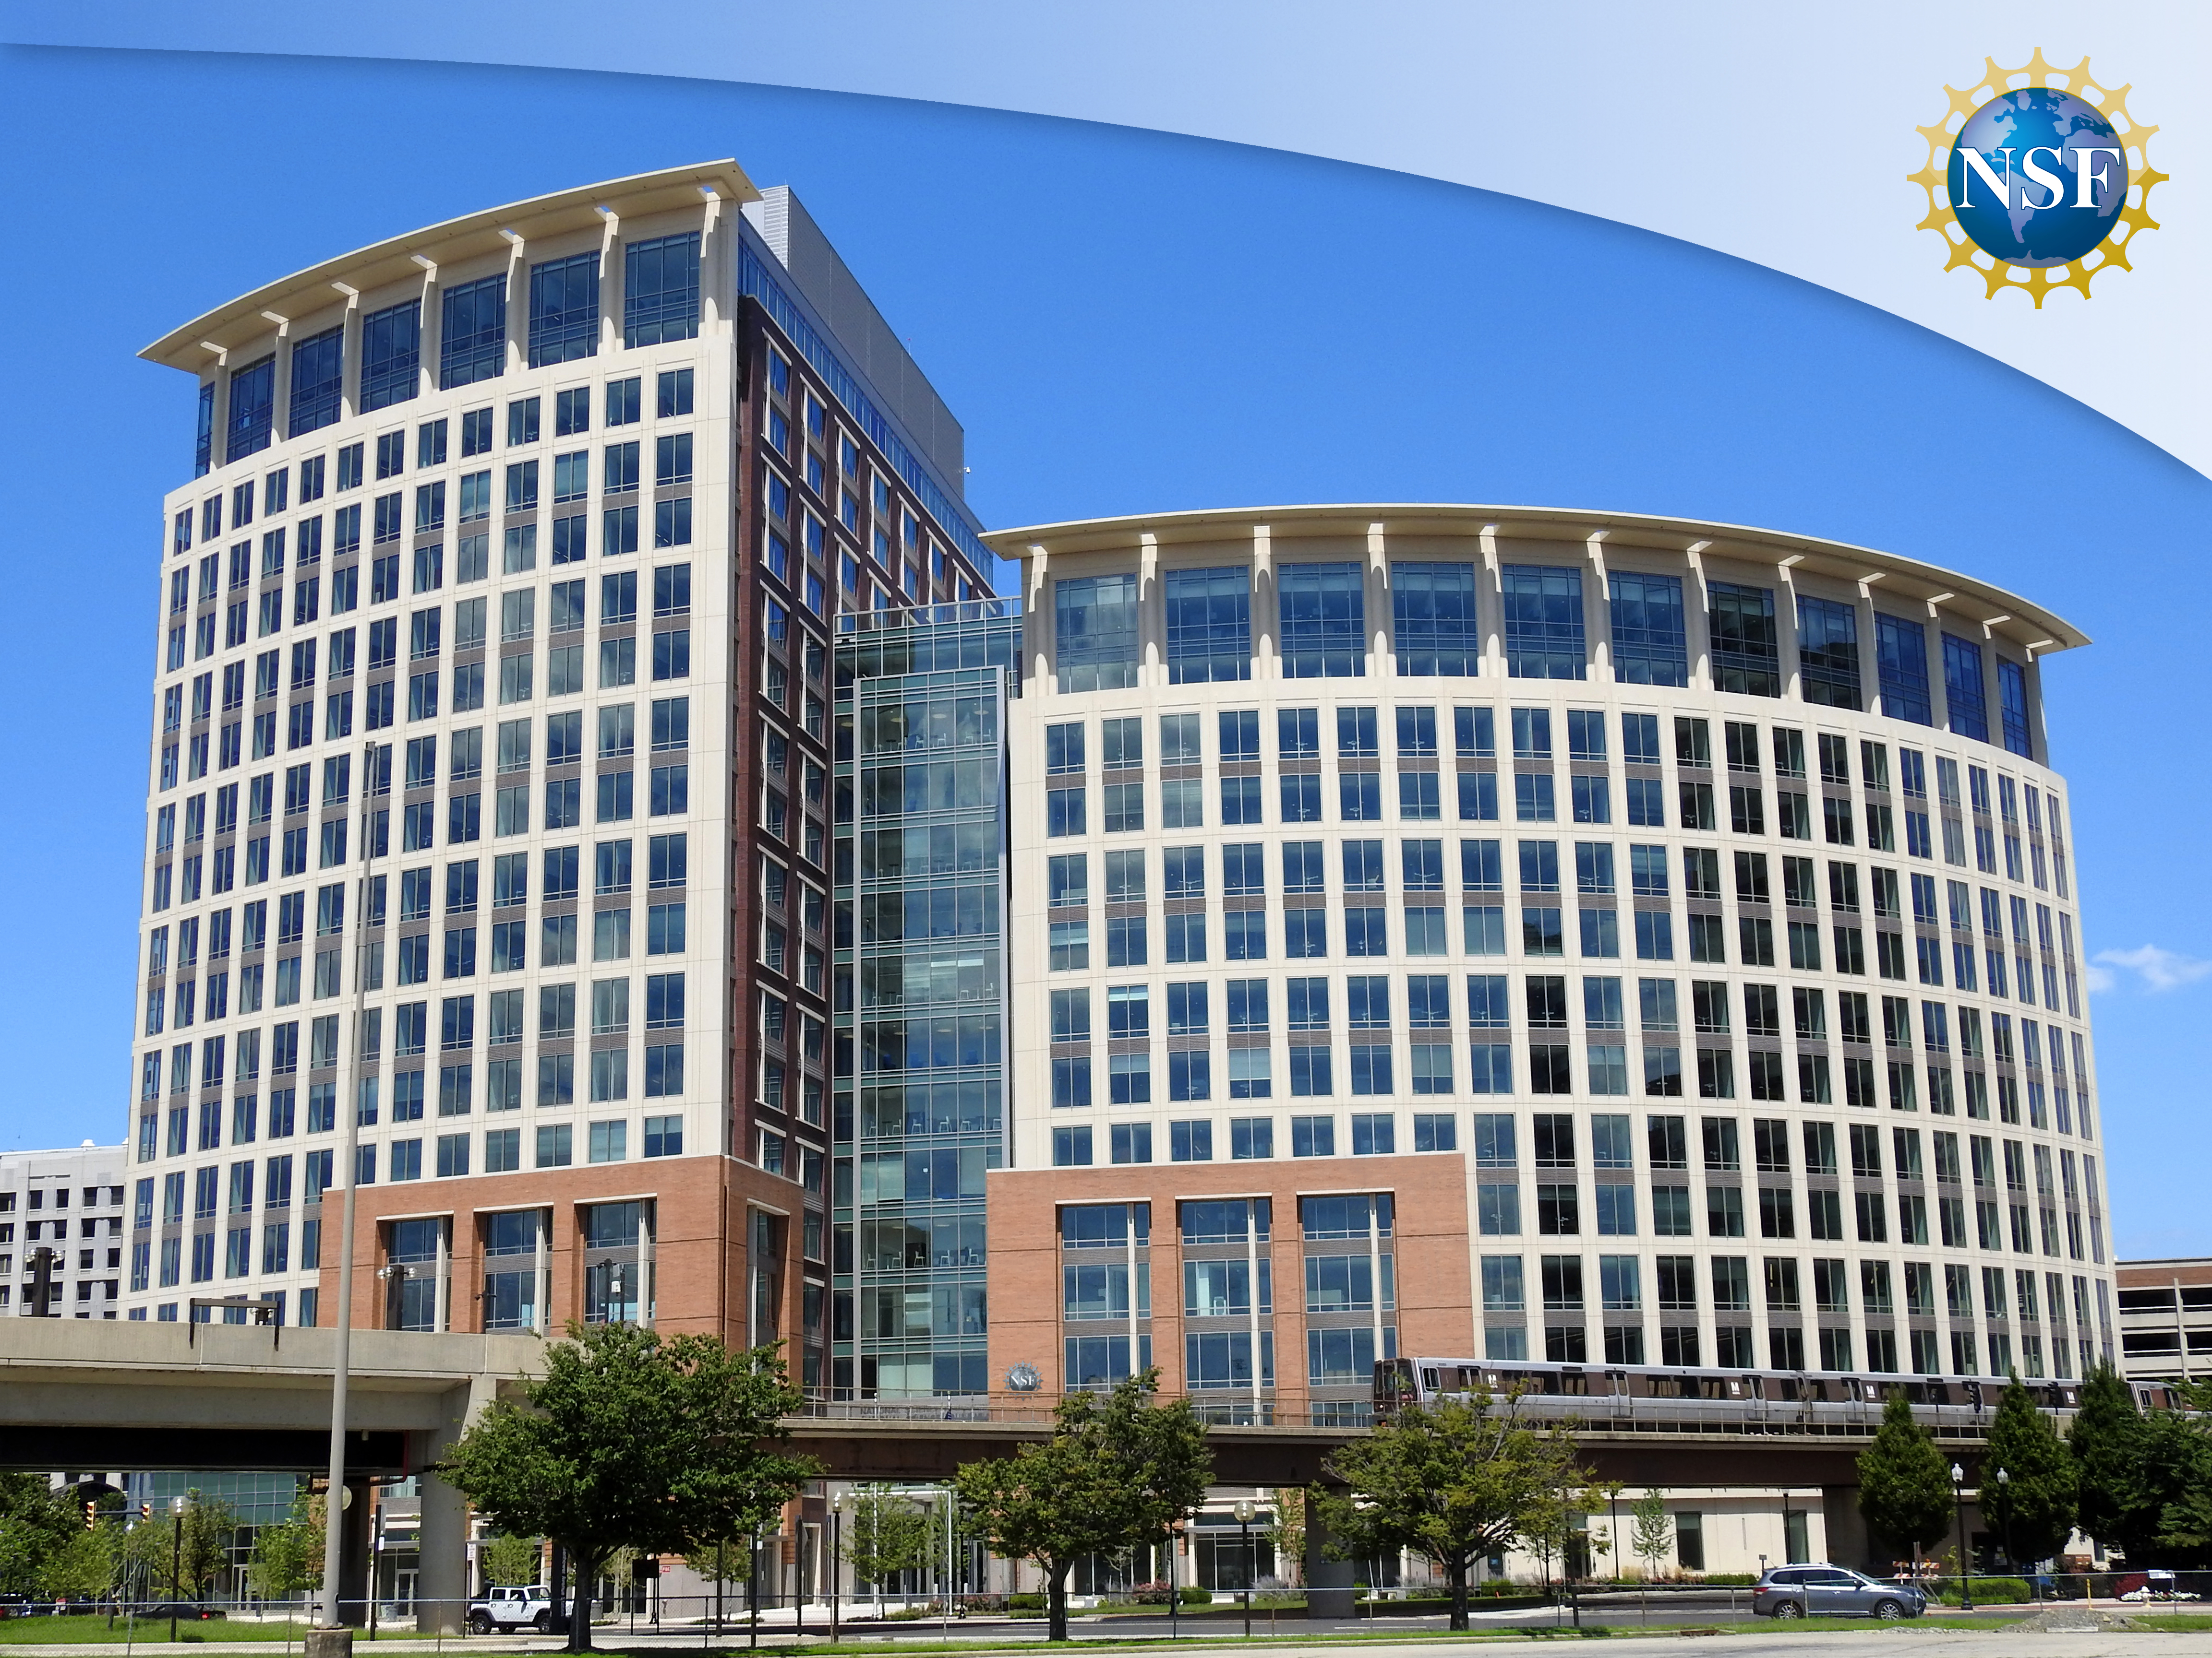
NSF In New Building
Moved to Alexandria VA in 2017

Slide 36
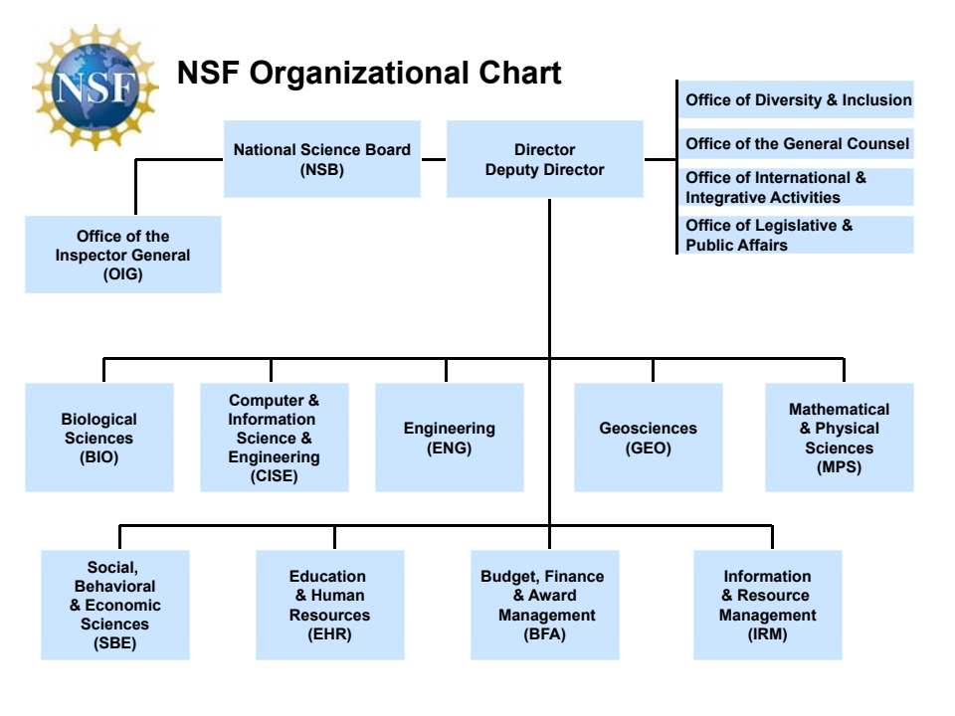
National Science Foundation - NP
Nuclear Physics

Slide 37
NSF
Recent Directors
Arden L. Bement, Jr PhD Metalurgical Engineering
Subra Suresh PhD Mechanical Engineering
France A. Córdova PhD Astrophysics
Sethuraman Panchanathan PhD Electrical and Computing Engineering
Appointed by President and Senate confirmed to 6 year terms

Slide 39
Directorate for Mathematical and Physical Sciences (MPS)
Division of Astronomical Sciences
Division of Chemistry
Division of Materials Research
Division of Mathematical Sciences
Division of Physics -> Nuclear Physics
Office of Strategic Initiatives

Slide 40
Nuclear Physics at the NSF
Staffed by three program officers
Experiment Allena Opper – NSF employee
Experiment “Rotator” Vicki Greene – IPA
Theory Bogdan Mihaila – NSF employee
NSF uses IPAs extensively and at all levels of management

Slide 41
NSF NP Funding
NP Funding is not called out in NSF funding request to Congress
From 2023 Long Range Plan

Slide 42
Nuclear Physics at NSF
Nuclear and hadron QCD
Nuclear astrophysics, reactions, and structure
Nuclear precision measurements of fundamental symmetries and constants
University labs at Florida State Univ. and Univ. of Notre Dame
Nuclear Theory & Theory Hubs
Co-review and co-funding with other NSF programs
Equipment Projects through NSF wide Major Research Instrumentation Mid-scale Research Infrastructure competitions

Slide 43
Nuclear Physics at the NSF
Experiment
“Supports experimental research at the frontiers of nuclear physics in the following areas: nuclear astrophysics, structure and reactions; nuclear and hadron quantum chromodynamics; precision measurements of fundamental symmetries and constants.”
Theory
“Supports research on fundamental theoretical aspects of nuclear physics, model building and applications to astrophysical phenomena and experimental programs at particle accelerator facilities.”

Slide 44
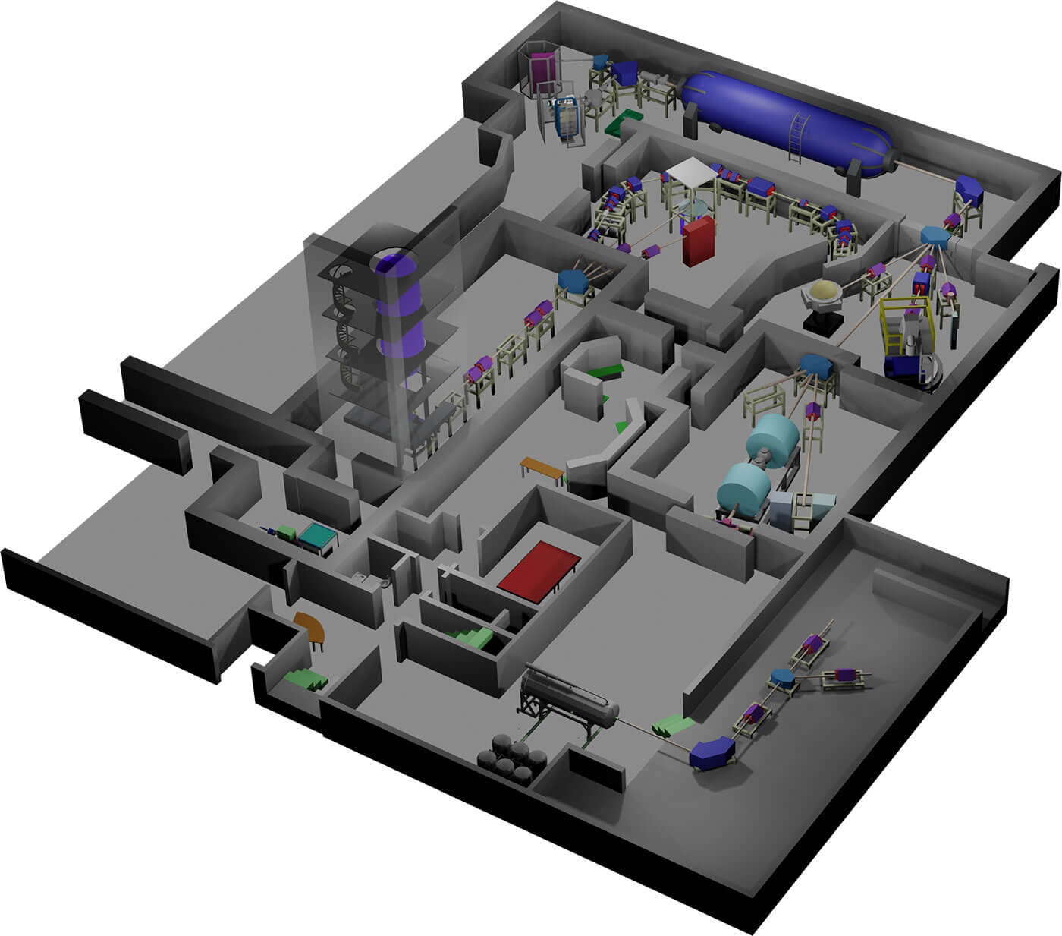
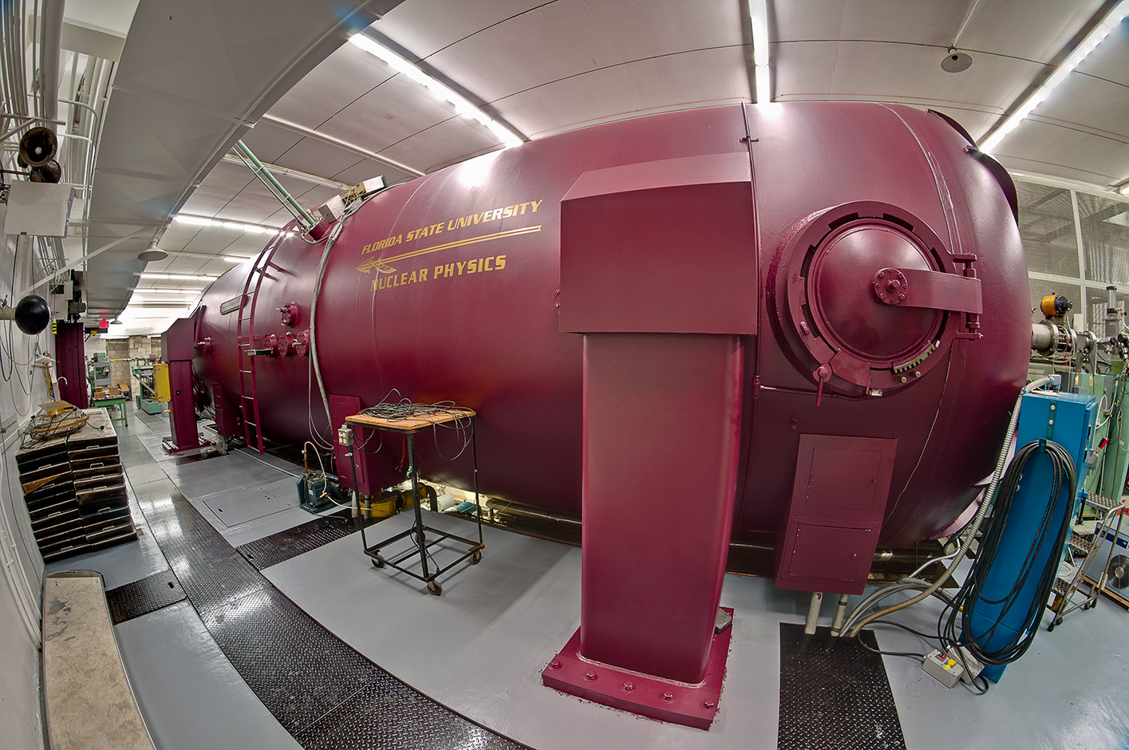
NSF Funded Labs
Notre Dame Nuclear Science Laboratory
John D. Fox Lab FSU

Slide 45
Example NSF MSRI Projects

Slide 46
Example NSF MSRI Projects

Slide 47
NSF Grant Process
NSF 2x-xxx: Division of Physics: Investigator-Initiated Research Projects (PHY)
Accept proposals each year, new and renewal - format indicated in FOA
Group or individual PIs
Typical proposal is for 3 years
Summer salary, post docs, grad students, possibly other staff, travel, possibly some equipment
All physics areas in one review process
Proposals are letter reviewed and then rated by panel
For successful proposals, 3yr budget negotiated (but subject to approp.)
At times NSF initiatives that match NP areas
MRI and MSRI separate process

Slide 48
Early Career Awards
Separate solicitation for early career scientists
Both DOE and NSF have programs
DOE both early career faculty and lab scientists
NSF early career faculty
They have different eligibility requirements – definition of “early”
Awards for 5 years

Slide 49
DOE NP 2022 Workforce Survey

Slide 50
DOE NP 2022 Workforce Survey

Slide 51
2023 Long Range Plan
Where Nuclear Physics PhDs are employed
10 yr post PhD
Most recent grads

Slide 52
From Tim Hallman NSAC talk 10/23

Slide 53
Nuclear Science Advisory Committee
Provides official advice to DOE and the NSF on the national program for basic nuclear science research
The Committee will provide advice and recommendations to the Director, Office of Science (DOE), and the Assistant Director,Mathematical & Physical Sciences Directorate (NSF), on determining the scientific priorities within the field of basic nuclear science research among the possible opportunities.
Responsibility for the direction of NSAC itself, selecting members, putting together meeting agendas and developing charges is shared by the two agencies.
Meets a few times a year for updates from agencies and to address charges as needed

Slide 54
Recent NSAC Charges
Charges can originate from NSF/DOE-NP, higher in DOE or even Congress
December 2023 – Charge to Office of Science Advisory Committees – Facilities Construction Projects
July 2022 – Nuclear Science Advisory Committee (NSAC) conduct a new study of the opportunities and priorities for United States nuclear physics research and recommend a long-range plan
April 2022 – NSAC Sub-Committee to assess challenges, opportunities, and priorities for effective stewardship of nuclear data.
March 2021 – Subcommittee on 99Molybdenum Seventh Annual Charge

Slide 55
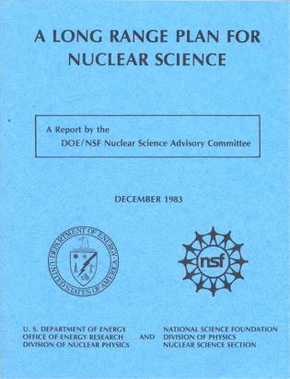
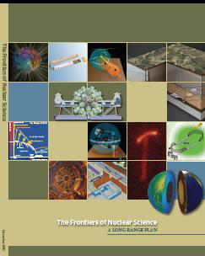
A Long History to NP Long Range Plans
2015
1979
1983
2009
1989
2002
1996
Plans presented to Congress.
Generally well received for setting priorities within realistic budgets.

Slide 56
2023 Long Range Plan
LRP charged to NSAC by DOE and NSF – July 2022
Writing Committee established – 62 members
White papers from community Town Hall meetings
Resolution meeting to finalize priorities
Released Oct. 2023
Nuclear Physics Day on Capitol Hill (November 8, 2023)

Slide 57
Long Range Plan Physics Questions
Nuclear science addresses some of the outstanding challenges to modern physics, including the properties and limits of matter, the forces of nature, and the evolution of the universe:
How do quarks and gluons make up protons, neutrons, and, ultimately, atomic nuclei?
How do the rich patterns observed in the structure and reactions of nuclei emerge from the interactions between neutrons and protons?
What are the nuclear processes that drive the birth, life, and death of stars?
How do we use atomic nuclei to uncover physics beyond the Standard Model?

Slide 58
Long Range Plan
Vision for the future builds on the ongoing, world-leading US program in nuclear science
Quark gluon structure and symmetries at CEBAF-12GeV
The nature of quark–gluon matter and the spin structure of the nucleon at RHIC and the heavy ion program at the Large Hadron Collider (LHC)
Breakthroughs in our understanding of nuclei and their role in the cosmos through research at the nation’s low-energy user facilities, ATLAS and FRIB, the ARUNA laboratories, and key national laboratory facilities.
A targeted program of experiments that reaches for physics beyond the Standard Model through rare process searches and precision measurements.
Explaining how data gathered in these endeavors are connected and consistent through theory and computation. Nuclear theory motivates, interprets, and contextualizes experiments, opening up fresh research vistas.

Slide 59
Long Range Plan Priorities
RECOMMENDATION 1 – The highest priority of the nuclear science community is to capitalize on the extraordinary opportunities for scientific discovery made possible by the substantial and sustained investments of the United States. We must draw on the talents of all in the nation to achieve this goal.
Increase the research budget
Continuing effective operation of the national user facilities ATLAS, CEBAF, and FRIB, and completing the RHIC science program
Raising the compensation of graduate researchers to levels commensurate with their cost of living without contraction of the workforce, lowering barriers and expanding opportunities in STEM for all
Expanding policy and resources to ensure a safe and respectful environment for everyone

Slide 60
Long Range Plan Priorities
RECOMMENDATION 2 – As the highest priority for new experiment construction, we recommend that the United States lead an international consortium that will undertake a neutrinoless double beta decay campaign, featuring the expeditious construction of ton-scale experiments, using different isotopes and complementary techniques.
RECOMMENDATION 3 – We recommend the expeditious completion of the EIC as the highest priority for facility construction.
d comple­mentary techniques.

Slide 61
Long Range Plan Priorities
RECOMMENDATION 4 – We recommend capitalizing on the unique ways in which nuclear physics can advance discovery science and applications for society by investing in additional projects and new strategic opportunities.
FRIB400, SoLID/Jlab, LHC Heavy Ion detector upgrades
Emerging technologies for measurements of neutrino mass and electric dipole moments
detector and accelerator R&D
quantum information science and technology
DOE Scientific Discovery through Advanced Computing (SciDAC) and NSF Cyberinfrastructure for Sustained Scientific Innovation programs
Nuclear Data

Slide 62
Long Range Plan DOE/NP Budget Scenarios
CHIPs act +12% in FY24 +2% per year
Robust program that addresses the priorities

Slide 63
Long Range Plan DOE/NP Budget Scenarios
Modest Growth +2% per year
Deliver a compelling program
Operations impacted to complete a delayed EIC and NLDBD
A modest investment in the research community

Slide 64
Appropriations Process
Two types of bills passed
Authorizations
Set policies and authorized activities
Include funding limits, usually optimistic for science agencies
Appropriations
Provides annual funding
May provide specific direction

Slide 65
Appropriations Process
House and Senate both have Appropriations Commitees with 12 subcomittees
They prepare 12 individual bills, one per subcommittee
Science agencies are in different subcommittee bills
DOE including the Office of Science is in Energy and Water subcommittee with e.g. Army Corps of Engineers
NSF is in Commerce subcommittee along with the Commerce Dept, Justice, NASA and more
NIH in Labor, Health and Human Services, and Education

Slide 66
Appropriations Timeline
Current FY+2
Agency
Office of Mgmt. And Budget
Secretary
Undersecretary
Office of Science
Program
Start formulation
Final Resolution
January
February
President’s Request
February
Spring
November

Slide 67
Appropriations Timeline
Current FY+1
Congress
President’s request declared dead on arrival
President’s Request and State of the Union Address
February
Appropriations subcommittees draft and approve bills
summer
Testemony by agency leaders
spring
House and Senate appropriations committee mark up and approve separate bills
summer
House and Senate pass final bills
Before October start of FY
Conference committee appointed to resolve differences in bills

Slide 68
Appropriations Timeline
Current FY
Agency
Begin execution of budget (often under continuing resolution)
October
Finalize budget when have final appropriation
Timing varies
NSF provides details of lower level budgets to Congress for approval
Most grants need to be recommended by early June for awards by end of FY

Slide 69
Action on FY25 Bills
House Energy and Water approved by full Committee
The actual bill has no detail only for Office of Science “$8,390,000,000, to remain available until expended”
Guidance in associated committee report
“The Nuclear Physics program supports research into the fundamental particles that compose nuclear matter, how they interact, and how they combine to form the different types of matter observed in the universe today. The recommendation includes not less than $105,000,000 for operations at the Facility for Rare Isotope Beams (FRIB) and not less than $150,000,000 for operations at the Continuous Electron Beam Accelerator Facility. The recommendation provides $15,000,000 for the High Rigidity Spectrometer. The Committee supports the FRIB Isotope Harvesting projects.”

Slide 70
Action on FY 2025 Bills
Senate Appropriations has held markup on Energy and Water bill but not yet approved by subcommittee
NSF
House +5.2% for Research and Related Activities
Senate does not yet have a bill approved by subcommittee

Slide 71
Thanks for your attention

Slide 72
Radiation Effects
BREAKING NEWS | ScienceInsider Friday 7/12/2024
Europa Clipper threatened by electronics flaws
NASA’s $5 billion flagship mission to explore Jupiter’s icy moon Europa, due for an October launch, could be in big trouble because some of its electronics may be vulnerable to Jupiter’s intense radiation. Recently, engineers discovered that some radiation-hardened transistors already sealed up inside the probe do not meet specifications. NASA is investigating the extent of the problem.

